Slide 1
Search Trees
Last time
  Binomial Heap
Today
  Review: Binary search tree, AVL tree
  Splay tree

Slide 2
Motivation
Efficient implementation of ordered dictionary
  Methods
    findElement(k)
    insertItem(k)
    RemoveItem(k)
  Other methods
    closestKeyBefore(k)
    closestElemBefore(k)
    closestKeyAfter(k)
    closestElemAfter(k)

Slide 3
Sorted table
  Binary search: O(log n)
  Insertion: O(n)
  Deletion: O(n)
  ClosestKeyBefore: O(logn)

Slide 4
Binary search tree
Definition:
  A binary tree,
  Where each internal node v stores an element e
  The left subtree of v are <= e
  The right subtree of v are >=e
Assume all external nodes are empty
The in-order traversal of binary search tree visits elements in non-decreasing order

Slide 5
A Binary Search Tree
50
30
60
55
65
25
40
20
57

Slide 6
Search A Binary Search Tree
Node binaryTreeSearch(Key k, Node v)
// Parameters: k, key to search
// v, the root of the subtree to search
// return a node when found match key
// otherwise, return an external node
{
if (v is an external node)
return v;
if (k == key(v))
return v;
else if (k < key(v))
binaryTreeSearch(k, v.leftChild());
else
binaryTreeSearch(k, v.rightChild());
}
Cost? Best case? Worst Case?

Slide 7
A Binary Search Tree: search 57
50
30
60
55
65
25
40
20
57

Slide 8
A Binary Search Tree: search 42
50
30
60
55
65
25
40
20
57

Slide 9
Insertion in a Binary Search Tree
To insert element e with key k.
Let w be the node returned by binaryTreeSearch()
  If w is an external node, replace it by an internal node with the key k and element e.
  If w is an internal node, continue to search its right subtree (or left subtree) until find an external node. Then apply case 1.

Slide 10
A Binary Search Tree: insert 42
50
30
60
55
65
25
40
20
57

Slide 11
A Binary Search Tree: insert 42
50
30
60
55
65
25
40
20
42
57

Slide 12
Removal in a Binary Search Tree
To remove a node with key k, Let w be the node returned by binaryTreeSearch(k, root)
  If w is an external node, done!
  If w is an internal node
    One of w’s children is an external node, z. Remove w and z, and replace w by z’s sibling
    Both children of node w are internal nodes
      Find internal node y that follows w in an inorder traversal
      Replace w’s content by y’s.
      Remove y using case (a).

Slide 13
A Binary Search Tree: remove 55
50
30
60
w
65
40
55
25
z
20
57

Slide 14
A Binary Search Tree: after removing 55
50
30
60
57
65
25
40
20

Slide 15
A Binary Search Tree: remove 60
50
30
60
55
65
25
40
20
57
62

Slide 16
A Binary Search Tree: remove 60
50
30
62
55
65
25
40
20
57
62

Slide 17
A Binary Search Tree: remove 60
50
30
62
55
65
25
40
20
57

Slide 18
AVL tree
Motivation
  Worst case linear time for a binary search tree
  Desire a height-balance tree so the height is in O(log n)
AVL tree
  A binary search tree that satisfies height-balance property
    Height-balance property: for every internal node, the heights of the children can differ by at most 1
  Height: O(log n)
Need to maintain height-balance property when inserting or deleting

Slide 19
Splay Trees
Apply splaying after every access to keep the search tree balanced in an amortized sense
Splaying
  Splay x by moving x to the root through a sequence of restructurings
  One specific operation depends on the relative positions of x, its parent y, and its grandparent z
    Zig-Zig
    Zig-Zag
    Zig

Slide 20
Splay x: zig-zig
The node x and its parent y are both left or right children
x
z
30
10
y
y
20
20
z
T₄
x
T₁
30
10
T₂
T₃
T₃
T₄
T₁
T₂

Slide 21
Splay x: zig-zag
One of x and y is a left child and the other is a right child.
z
10
y
x
20
30
z
y
T₁
T₄
10
30
20
x
T₁
T₂
T₃
T₄
T₂
T₃

Slide 22
Splay x: zig
The node x does not have a grandparent (or the grandparent is
not of our concern)
y
10
x
x
20
20
y
T₁
10
T₂
T₃
T₃
T₁
T₂

Slide 23
Example of Splaying a Node
8
11
2
12
4
15
6
13
17
5
7
14
Splay 14

Slide 24
Example of Splaying a Node
8
11
2
12
4
15
6
T4
13
17
5
7
T1
14
T2
T3
Zig-zag

Slide 25
Example of Splaying a Node
8
11
2
12
4
6
14
13
15
5
7
T1
T2
T4
T3
17
After the Zig-zag

Slide 26
Example of Splaying a Node
8
11
2
12
4
6
14
13
15
5
7
17
Splaying continues

Slide 27
Example of Splaying a Node
8
11
2
T1
12
4
T2
6
14
T4
T3
15
13
5
7
17
Zig-Zig

Slide 28
Example of Splaying a Node
8
14
2
T4
4
12
15
6
T3
17
11
13
5
7
T1
T2
After the Zig-Zig

Slide 29
Example of Splaying a Node
8
14
2
4
12
15
6
11
13
17
5
7
Splaying continues

Slide 30
Example of Splaying a Node
8
T1
14
2
T2
T3
4
12
15
6
11
13
17
5
7
Zig

Slide 31
Example of Splaying a Node
14
8
T1
2
T2
T3
4
12
15
6
11
13
17
5
7
After the Zig

Slide 32
When to Splay
When searching for key k, splay the found internal node or the parent of the external node when search fails
When inserting a key k, splay the newly created internal node
When deleting a key k, splay the parent of the node that gets removed (See slide: Removal in a Binary Search Tree).

Slide 33
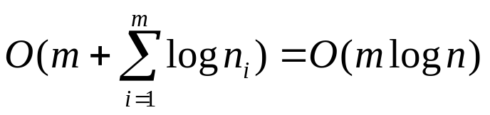
Properties of Splay Trees
Linear depth when inserting keys in increasing order
  What’s the worst case cost for search, insertion, and deletion respectively?
Consider a sequence of m operations on a splay tree, each a search, insertion, or deletion, starting from an empty tree with zero keys, also let n_{i} be the number of keys in the tree after operation i, and n be the total number of insertions. The total running time for performing the sequence of operations is

Slide 34
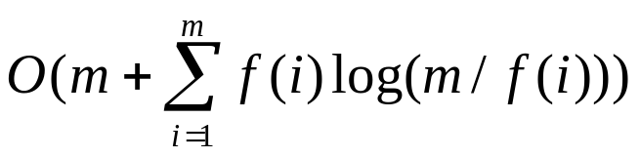
Properties of Splay Trees
Consider a sequence of m operations on a splay tree, each a search, insertion, or deletion, starting from an empty tree with zero keys, also let f(i) be the number of times the item i is accessed in the splay tree, that is, its frequency, and let n be total number of items. Assuming that each item is accessed at least once, then the total running time for performing the sequence of operations is

